Slide 1
Secure DaTa hiding in image using Steganography
CAPSTONE PROJECT
Presented By: Vikas yadav
Student Name : Vikas yadav
College Name & Department : Dronacharya college of Engineering (CSE)

Slide 2
OUTLINE
Problem Statement
Technology used
Wow factor
End users
Result
Conclusion
Git-hub Link
Future scope

Slide 3
Problem Statement
To Hide a secret message in image . Security agencies and Defence and for confidentiality , how to send secret message.

Slide 4
Technology used
Platform : Python IDE shell 3.13.2
Libraries: CV2, String

Slide 5
Wow factors
What makes this project stand out from other project(Unique features).
Security agencies can use this to track unlawful activities of messages on e-mail's and social media.

Slide 6
End users
Ssecurity Agencies and Govt. Institutions

Slide 7
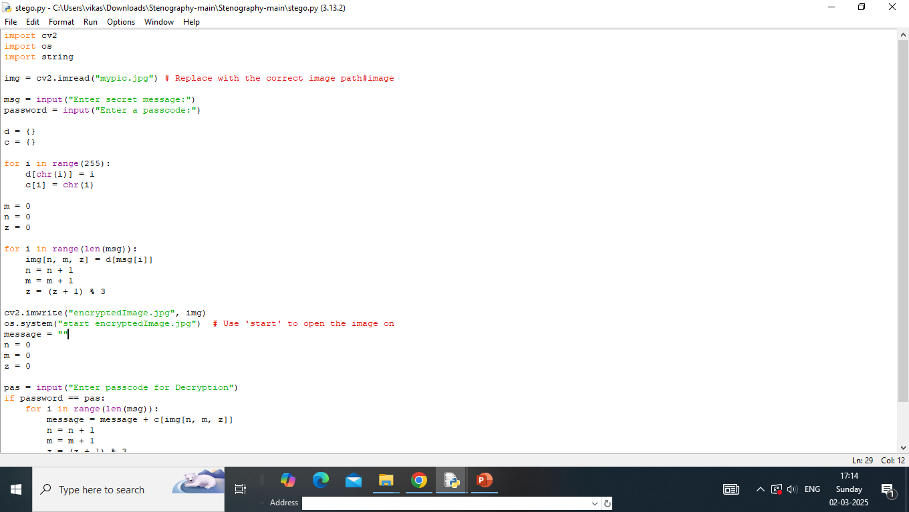
Results

Slide 8
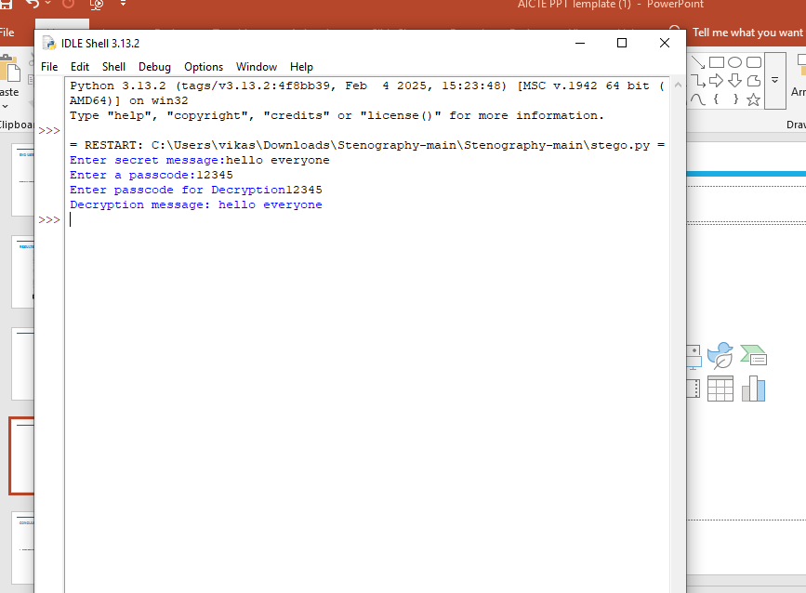
output

Slide 9
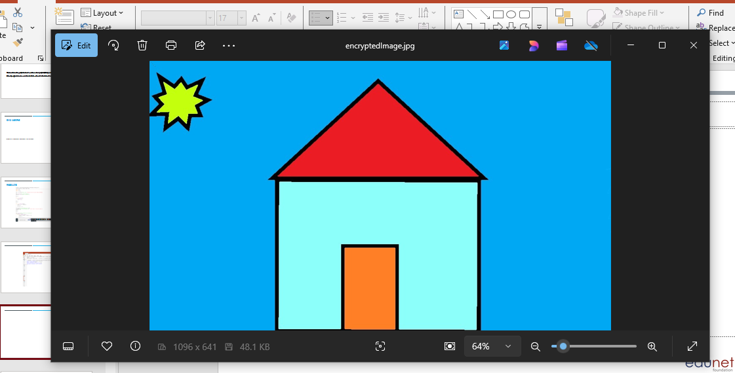
Encrypted image

Slide 10
Conclusion
Don’t use technology for any unlawful activities

Slide 11
GitHub Link
https://github.com/Gtbpi99/aicteproject.git

Slide 12
Future scope(optional)

Slide 13
THANK YOU

